Slide 1
Mobile Programming with Android Lecture 06 – Android Widget
Charisma Tubagus S

Slide 2
Program Relative
Start New Android Studio Project
In configure your project window, fill out the following
Application Name: Relative
Company Domain: write whatever you want
Project Location: Leave as default
In target Android Devices, pick the Minimum SDK as Gingerbread
In the activity window, pick the Empty Activity
In the customize Activity window, fill Activity Name as MainActivity and leave as default one

Slide 3
activity_main.xml
<?xml version="1.0" encoding="utf-8"?>
<RelativeLayout
xmlns:android="http://schemas.android.com/apk/res/android"
android:layout_width="fill_parent"
android:layout_height="wrap_content"
android:padding="5px">
<TextView android:id="@+id/label"
android:layout_width="wrap_content"
android:layout_height="wrap_content"
android:text="Nama :"
android:paddingTop="15px"/>

Slide 4
activity_main.xml
<EditText
android:id="@+id/entry"
android:layout_width="fill_parent"
android:layout_height="wrap_content"
android:layout_toRightOf="@id/label"
android:layout_alignBaseline="@id/label"/>
<Button
android:id="@+id/ok"
android:layout_width="wrap_content"
android:layout_height="wrap_content"
android:layout_below="@id/entry"
android:layout_alignRight="@id/entry"
android:text="OK" />

Slide 5
activity_main.xml
<Button
android:id="@+id/cancel"
android:layout_width="wrap_content"
android:layout_height="wrap_content"
android:layout_toLeftOf="@id/ok"
android:layout_alignTop="@id/ok"
android:text="Cancel" />
</RelativeLayout>

Slide 6
MainActivity.java
package com.wilis.relative;
import android.app.Activity;
import android.os.Bundle;
public class MainActivity extends Activity {
/** Called when the activity is first created. */
@Override
public void onCreate(Bundle savedInstanceState) {
super.onCreate(savedInstanceState);
setContentView(R.layout.main);
}
}

Slide 7
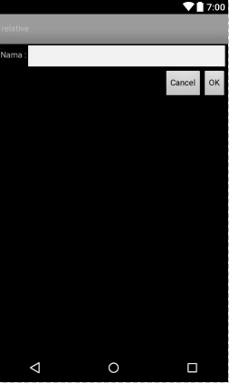

Slide 8
Program Tabula
Start New Android Studio Project
In configure your project window, fill out the following
Application Name: Tabula
Company Domain: write whatever you want
Project Location: Leave as default
In target Android Devices, pick the Minimum SDK as Gingerbread
In the activity window, pick the Empty Activity
In the customize Activity window, fill Activity Name as MainActivity and leave as default one

Slide 9
activity_main.xml
<?xml version="1.0" encoding="utf-8"?>
<TableLayout
xmlns:android="http://schemas.android.com/apk/res/android"
android:layout_width="fill_parent"
android:layout_height="fill_parent"
android:stretchColumns="1">
<TableRow>
<TextView
android:text="Nama :" />
<EditText android:id="@+id/entry"
android:layout_span="3"/>
</TableRow>

Slide 10
activity_main.xml
<View
android:layout_height="2px"
android:background="#0000FF" />
<TableRow>
<Button android:id="@+id/cancel"
android:layout_column="2"
android:text="Cancel" />
<Button android:id="@+id/ok"
android:text="OK" />
</TableRow>
</TableLayout>

Slide 11
MainActivity.java
package com.wilis.tabula;
import android.app.Activity;
import android.os.Bundle;
public class MainActivity extends Activity {
/** Called when the activity is first created. */
@Override
public void onCreate(Bundle savedInstanceState) {
super.onCreate(savedInstanceState);
setContentView(R.layout.main);
}
}

Slide 12
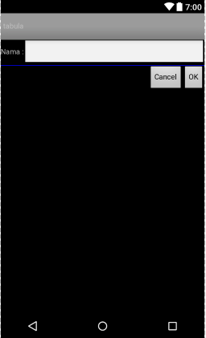

Slide 13
Program Scroll
Start New Android Studio Project
In configure your project window, fill out the following
Application Name: Scroll
Company Domain: write whatever you want
Project Location: Leave as default
In target Android Devices, pick the Minimum SDK as Gingerbread
In the activity window, pick the Empty Activity
In the customize Activity window, fill Activity Name as MainActivity and leave as default one

Slide 14
activity_main.xml
<?xml version="1.0" encoding="utf-8"?>
<ScrollView
xmlns:android="http://schemas.android.com/apk/res/android"
android:layout_width="fill_parent"
android:layout_height="wrap_content">
<TableLayout
android:layout_width="fill_parent"
android:layout_height="fill_parent"
android:stretchColumns="0">
<TableRow>
<View
android:layout_height="80px"
android:background="#000000"/>
<TextView android:text="Baris ke-1"
android:paddingLeft="4px"
android:layout_gravity="center_vertical" />
</TableRow>

Slide 15
activity_main.xml
<TableRow>
<View
android:layout_height="80px"
android:background="#440000" />
<TextView android:text="Baris ke-2"
android:paddingLeft="4px"
android:layout_gravity="center_vertical" />
</TableRow>
<TableRow>
<View
android:layout_height="80px"
android:background="#884400" />
<TextView android:text="Baris ke-3"
android:paddingLeft="4px"
android:layout_gravity="center_vertical" />
</TableRow>

Slide 16
activity_main.xml
<TableRow>
<View
android:layout_height="80px"
android:background="#aa8844" />
<TextView android:text="Baris ke-4"
android:paddingLeft="4px"
android:layout_gravity="center_vertical" />
</TableRow>
<TableRow>
<View
android:layout_height="80px"
android:background="#ffaa88" />
<TextView android:text="Baris ke-5"
android:paddingLeft="4px"
android:layout_gravity="center_vertical" />
</TableRow>

Slide 17
activity_main.xml
<TableRow>
<View
android:layout_height="80px"
android:background="#ffffaa" />
<TextView android:text="Baris ke-6"
android:paddingLeft="4px"
android:layout_gravity="center_vertical" />
</TableRow>
<TableRow>
<View
android:layout_height="80px"
android:background="#ffffff" />
<TextView android:text="Baris ke-7"
android:paddingLeft="4px"
android:layout_gravity="center_vertical" />
</TableRow>

Slide 18
activity_main.xml
<TableRow>
<View
android:layout_height="80px"
android:background="#ffffaa" />
<TextView android:text="Baris ke-8"
android:paddingLeft="4px"
android:layout_gravity="center_vertical" />
</TableRow>
<TableRow>
<View
android:layout_height="80px"
android:background="#ffffff" />
<TextView android:text="Baris ke-9"
android:paddingLeft="4px"
android:layout_gravity="center_vertical" />
</TableRow>

Slide 19
activity_main.xml
<TableRow>
<View
android:layout_height="80px"
android:background="#ffffaa" />
<TextView android:text="Baris ke-10"
android:paddingLeft="4px"
android:layout_gravity="center_vertical" />
</TableRow>
</TableLayout>
</ScrollView>

Slide 20
MainActivity.java
package com.wilis.scroll;
import android.app.Activity;
import android.os.Bundle;
public class MainActivity extends Activity {
/** Called when the activity is first created. */
@Override
public void onCreate(Bundle savedInstanceState) {
super.onCreate(savedInstanceState);
setContentView(R.layout.main);
}
}

Slide 21
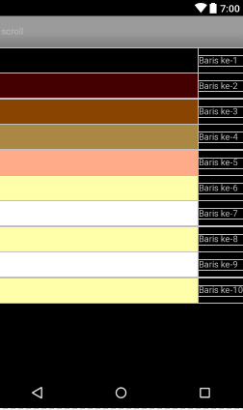

Slide 22
Program ListView
Start New Android Studio Project
In configure your project window, fill out the following
Application Name: ListView
Company Domain: write whatever you want
Project Location: Leave as default
In target Android Devices, pick the Minimum SDK as Gingerbread
In the activity window, pick the Empty Activity
In the customize Activity window, fill Activity Name as MainActivity and leave as default one

Slide 23
activity_main.xml
<?xml version="1.0" encoding="utf-8"?>
<LinearLayout
xmlns:android="http://schemas.android.com/apk/res/android"
android:orientation="vertical"
android:layout_width="fill_parent"
android:layout_height="fill_parent" >
<TextView
android:id="@+id/selection"
android:layout_width="fill_parent"
android:layout_height="wrap_content"/>
<ListView
android:id="@android:id/list"
android:layout_width="fill_parent"
android:layout_height="fill_parent"
android:drawSelectorOnTop="false"
/>
</LinearLayout>

Slide 24
MainActivity.java
package com.wilis.listview;
import android.os.Bundle;
import android.app.ListActivity;
import android.view.View;
import android.widget.ArrayAdapter;
import android.widget.ListView;
import android.widget.TextView;

Slide 25
MainActivity.java
public class listview extends ListActivity {
TextView selection;
String[] items={"Aceh", "Sumatera Utara", "Sumatera Barat", "Riau", "Jambi","Sumatera Selatan", "Bengkulu", "Lampung", "Bangka Belitung", "Kepulauan Riau","Jakarta", "Jawa Barat", "Jawa Tengah", "Yogyakarta", "Jawa Timur","Banten", "Bali", "Nusa Tenggara Barat", "Nusa Tenggara Timur", "Kalimantan Barat","Kalimantan Tengah", "Kalimantan Selatan", "Kalimantan Timur", "Sulawesi Utara", "Sulawesi Tengah","Sulawesi Selatan","Sulawesi Tenggara","Gorontalo","Sulawesi Barat",
"Maluku","Maluku Utara","Papua Barat","Papua"};

Slide 26
MainActivity.java
@Override
public void onCreate(Bundle icicle) {
super.onCreate(icicle);
setContentView(R.layout.main);
setListAdapter(new ArrayAdapter<String>(this, android.R.layout.simple_list_item_1,
items));
selection=(TextView)findViewById(R.id.selection);
}
public void onListItemClick(ListView parent, View v, int position, long id) {
selection.setText(items[position]);
}
}

Slide 27
